Slide 1
Building a java web application - 2
Java in practice
December 1, 2016

Slide 2
Encryption in Java
Agenda for today
Http Session
Authentication
Realms

Slide 3

Sessions
HTTP is a “stateless” protocol which means each time a client retrieves a web page, the client opens a separate connection to the web server and the server does not automatically keep any record of previous client request.

Slide 4
Sessions
Three ways to maintain a session:
Cookies – the web server assigns a unique session ID as a cookie to each web client. The subsequent requests by the client are recognized by the cookie. Drawback a client may not support cookies.
Hidden form fields - the web client can assign hidden field to a form. But this limits the requests to GET and POST and if a regular link is followed this will not work.
URL rewriting – a parameter with the unique session id can be added to the URL. Drawback need to generate the URL dynamically though the page is static. It is tedious to keep track

Slide 5
Session in java servlet - HttpSession
Servlet API provides a session management API. It is built on top of the other methods for session tracking.
The HttpSession allows us to set objects as attributes that can be retrieved in future requests.
The HttpSession can be retrieved from HttpServletRequest object as follows:
HttpSession getSession() – This method always returns a HttpSession object. It returns the session object attached with the request. If the request has no session, then it creates new and returns it.
HttpSession getSession(Boolean flag) – It returns the session object if request has session else it returns false.

Slide 6
Tomcat sessions default behavior
By default Tomcat directly sends cookies in the HTTP response and rewrites the URL to add JSESSIONID parameter for the first request, so that it can fall back to it later in case cookies are disabled in the client browser.
The default behavior can be overridden in META-INF/context.xml
All context attributes are listed in tomcat documentation:
https://tomcat.apache.org/tomcat-8.0-doc/config/context.html#Naming

Slide 7
Authentication
BASIC – The client sends the user name and password as unencrypted base64 encoded text. It should only be used with HTTPS, as the password ca be easily captured and reused.
Example:
Authorization: Basic cGV0eWE6MTIz

Slide 8
Authentication
DIGEST – The client sends a hashed form of the password to the server.
Client sends a request to protected resource
The server returns 401 “Unauthorized”, providing authentication realm and randomly generated single use value – nonce
The browser will present the authentication realm to the user and will prompt for user name and password.
Once the user name and password have been supplied the client re-sends the same request but adds an authentication header.
More information available in RFC https://tools.ietf.org/html/rfc2617
And wiki https://en.wikipedia.org/wiki/Digest_access_authentication

Slide 9
Authentication
FORM – Uses the standard HTML form fields to pass the username and password value to the server. The server validates the credentials and creates a session that is tied to unique key. When the user log off the server invalidates the unique key.

Slide 10
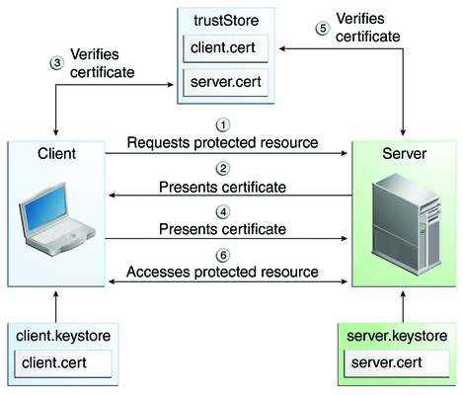
Authentication
CLIENT-CERT – Also known as mutual authentication or two way authentication. Both parties authenticate to each other at the same time. They present to each other a digital certificate and each party verifies it against a trusted store with certificate authorities.

Slide 11
Specifying authentication mechanism
Authentication mechanism are setup in WEB-INF/web.xml file.
Example setting form authentication:
<login-config>
<auth-method>FORM</auth-method>
<realm-name>file</realm-name>
<form-login-config>
<form-login-page>/login.xhtml</form-login-page>
<form-error-page>/error.xhtml</form-error-page>
</form-login-config>
</login-config>

Slide 12
What is a realm?
A Realm is a "database" of usernames and passwords that identify valid users of a web application (or set of web applications), plus an enumeration of the list of roles associated with each valid user.
Tomcat defines an java interface org.apache.catalina.Realm that can be implemented as a “plug-in” component to be used as a connection between the servlet container and existing authentication database or any other mechanism that already exists.
6 types of built-in Realms

Slide 13
Built-in realms
JDBC realm – access authentication information stored in a relational DB via JDBC driver.
DataSourceRealm – access authentication information stored in a relational DB via JNDI JDBC DataSource.
JNDIRealm – access authentication information stored in a LDAP based directory server.
UserDatabaseRealm - Accesses authentication information stored in an UserDatabase JNDI resource, which is typically backed by an XML document (conf/tomcat-users.xml).
MemoryRealm - Accesses authentication information stored in an in-memory object collection, which is initialized from an XML document (conf/tomcat-users.xml).
JAASRealm - Accesses authentication information through the Java Authentication & Authorization Service (JAAS) framework.

Slide 14
Exercise
Configure form authentication with custom Realm which validates the user credentials.
If the user credentials are correct display a Welcome page else display error page.

Slide 15

Questions?

Slide 16
Thanks for your attention!
Petya Karastoyanova
pkarastoyanova@axway.com

